Slide 1
Some information about table extraction
May 14, 2020

Slide 2
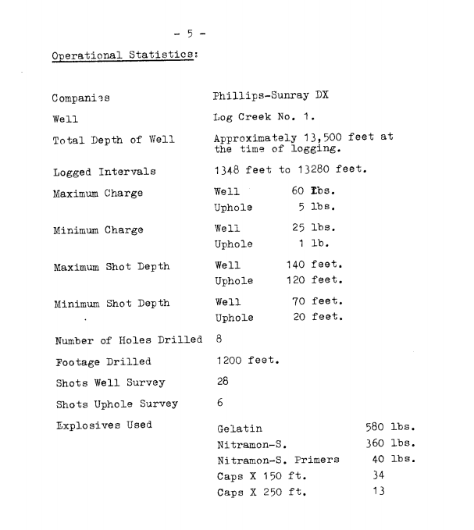
Borehole-containing table in cr_1799_7
Original page
Table from Textract
Table: Table_4
Companies | Phillips-Sunray DX
Well | Log Creek No. 1.
Total Depth of Well | Approximately 13,500 feet the time of logging.
Logged Intervals | 1348 feet to 13280 feet.
Maximum Charge | Well 60 Lbs.
 | Uphole 5 lbs.
Minimum Charge | Well 25 lbs.
 | Uphole 1 lb.
Maximum Shot Depth | Well 140 feet.
 | Uphole 120 feet.
Minimum Shot Depth | Well 70 feet.
 | Uphole 20 feet.
Number of Holes Drilled | 8
Footage Drilled | 1200 feet.
Shots Well Survey | 28
Shots Uphole Survey | 6
Explosives Used | Gelatin
 | Nitramon-S
 | Nitramon-S. Primers
 | Caps X 150 ft.
 | Caps X 250 ft.

Slide 3
Table from Wondershare
Table: Table 5
Companies | Phillips-Sunray DX | Phillips-Sunray DX | Phillips-Sunray DX | Phillips-Sunray DX
Well | Log Creek No, 1 . | Log Creek No, 1 .
Total Depth of Well | Approximately 13 r 500 the time of logging. | Approximately 13 r 500 the time of logging. | feet at | feet at
Logged Intervals | 1348 feet to 13280 feet. | 1348 feet to 13280 feet. | 1348 feet to 13280 feet.
Maximum Charge | Well | 60 Tbs.
 | Uphole | 5 lbs.
Minimum Charge | Well | 25 lbs.
 | Uphole | 1 lb.
Maximum Shot Depth | Well | 140 feet.
 | Uphole | 120 feet.
Minimum Shot Depth | Well | 70 feet.
 | Uphole | 20 feet.
Number of Holes Drilled | 8
Footage Drilled | 1200 feet.
Shots Well Survey | 28
Shots Uphole Survey | 6
Explosives Used | Gelatin |  | 580 | lbs.
 | Nitramon-S, |  | 360 | lbs.
 | Nitramon-S. | Primers | 40 | lbs.
 | Caps X 150 | ft. | 34
 | Caps X 250 | ft. | 13

Slide 4
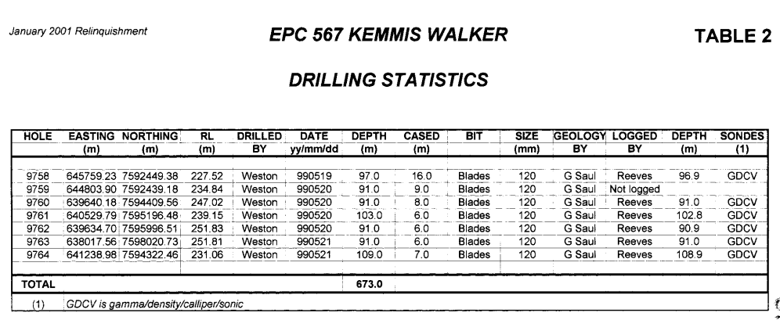
Borehole-containing table in cr_32730_1

Slide 5
Table: Table_2
HOLE | EASTING | NORTHING | RL | DRILLED | DATE | DEPTH | CASED | BIT | SIZE | GEOLOGY | LOGGED | DEPTH | SONDES
 | (m) | (m) | (m) | BY | yy/mm/dd | (m) | (m) |  | (mm) | BY | BY | (m) | -1
9758 | 645759.2 | 7592449 | 227.52 | Weston | 990519 | 97 | 16 | Blades | 120 | G Sau | Reeves | 96.9 | GDCV
9759 | 644803.9 | 7592439 | 234.84 | Weston | 990520 | 91 | 9 | Blades | 120 | G Saul | Not logged
9760 | 639640.2 | 7594410 | 247.02 | Weston | 990520 | 91 | 8 | Blades | 120 | G Saul | Reeves | 91 | GDCV
9761 | 640529.8 | 7595196 | 239.15 | Weston | 990520 | 103 | 6 | Blades | 120 | G Saul | Reeves | 102.8 | GDCV
9762 | 639634.7 | 7595997 | 251.83 | Weston | 990520 | 91 | 6 | Blades | 120 | G Saul | Reeves | 90.9 | GDCV
9763 | 638017.6 | 7598021 | 251.81 | Weston | 990521 | 91 | 6 | Blades | 120 | G Saul | Reeves | 91 | GDCV
9764 | 641239 | 7594322 | 231.06 | Weston | 990521 | 109 | 7 | Blades | 120 | G Saul | Reeves | 108.9 | GDCV
Table from Textract
Table: Table 2
HOLE | EASTING | NORTHING | RL | DRILLED | DATE I | DEPTH | CASED i | BIT | SIZE | {GEOLOGY | LOGGED | DEPTH | SONDES
 | (m) | (m) | (m) | BY | yy/mm/dd | (m) | (m) |  | (mm) | BY | BY | (m) | (D
9758 | 645759.2 | 7592449.4 | 227.52 | i Weston | 990519 | 97 | 16 | Blades | 120 | G Saul | Reeves | 96.9 | GDCV
9759 | 644803.9 | 7592439.2 | 234.84 | i Weston | 990520 | 91 | â– 9.0 | Blades | 120 | G Saul | Not logged
9760 | â– 639640.18 | 7594409.6 | 247.02 | i Weston | 990520 | 91 | ' 8.0 | Blades | 120 | G Saul | Reeves | 91 | GDCV
9761 | : 640529.79 | 7595196.5 | 239.15 | : Weston | 990520 | 103 | 6 | Blades | 120 | G Saul | Reeves | 102.8 | GDCV
9762 | 639634.7 | 7595996.5 | 251.83 | : Weston | 990520 | 91 | i 6.0 | Blades | 120 | G Saul | Reeves | 90.9 | GDCV
9763 | 638017.6 | 7598020.7 | 251.81 | Weston | 990521 | 91 | i 6.0 | Blades | 120 | G Saul | Reeves | 91 | GDCV
9764 | 641239 | 7594322.5 | 231.06 | Weston | 990521 | 109 | i 7.0 | Blades | 120 | G Saul | Reeves | 108.9 | GDCV
Table from Wondershare

Slide 6
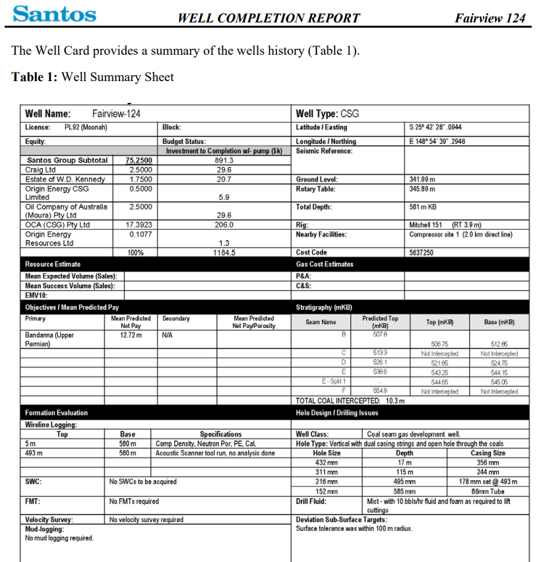
Well Card in cr_46519_1
Table from Textract
Table: Table_4
Well Name: | Fairview-124 |  | Well Type: CSG
Licence: PL92 (Moonah) |  | Block: | Latitude Easting | S 259 42 28" 0944
Equity |  | Budget Status: | Longitude Northing | E 1489 54 39" 2946
 |  | Investment to Completion wl. pump (Sk) | Seismic Reference:
Santos Group Subtotal | 75.25 | 891.3
Craig Ltd | 2.5 | 29.6
Estate of W.D. Kennedy | 1.75 | 20.7 | Ground Level: | 341.99 m
Origin Energy CSG Limited | 0.5 | 5.9 | Rotary Table: | 345.89 m
Oil Company of Australia (Moura) Pty Ltd | 2.5 | 29.6 | Total Depth: | 581 m KB
OCA (CSG) Pty Ltd | 17.3923 | 206 | Rig: | Mitchel 151 (RT 3.9 m)
Origin Energy Resources Ltd | 0.1077 | 1.3 | Nearby Facilities: | Compressor site 1 (2.0 km direct line)

Slide 7
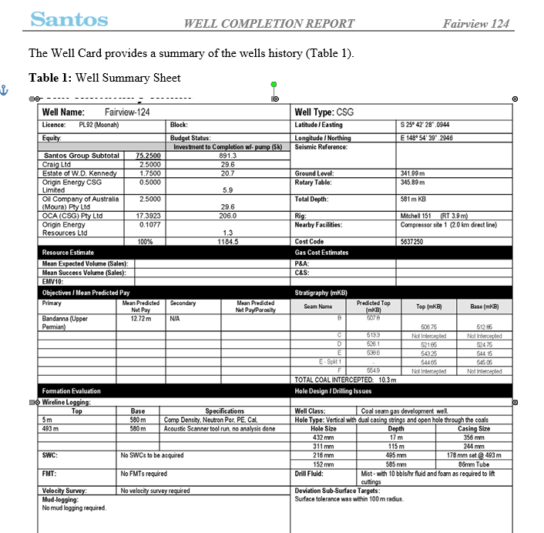
Table from Wondershare: missing.
Well Card has been read in as image.

Slide 8
Evaluation of BH Extraction from tables extracted from Textract and Wondershare intersect files
ReportID | File | Borehole | In Textract? | In Wondershare?
1799 | 6/7 | Log Creek No 1 | ✔ | ✔
14142 | 3/10/15/23 | Bodalla South #2 | ✔ | ✔✔
23455 | 1/12/13/15 | Rum Botle-1 | ✔✔ | ✔✔
27932 | 2 | Fairview #1 | ✔✔ | ✔
28822 | 5 | Bargie-1 | ✔ | ✔
28822 | 4/5/9 | Bargie-3 | ✔ | ✔
31511 | 1 | Michaela-1 | ✔ | Corrupted - other text on the line
33931 | 1 | Fairview #36 | ✔ | ✔✔
37802 | 1 | Tipton West-2 | ✔ | ✔
42688 | 1 | Fairview #97 | ✔ | ✔
46519 | 1/4 | Fairview-124 | ✔ | X
53382 | 1 | RH015GL1V | ✔ | X
63981 | 1 | Glenaras 6 | ✔ | ✔
68818 | 1/4 | Meeleebee 2 | ✔ | ✔
Score: |  |  | 16 | 14
Ticks indicate if borehole name was found, and second tick if location was also found.
Conclusion: Textract tables were able to get more borehole information out than Wondershare, which had information on a few reports missing completely.
However, as extraction was tuned on Textract tables, it should be fair to review where Wondershare failed, use it to improve extraction if possible, and re-evaluate once this is done.

Slide 9
Slice of ground truth
ReportID | file_name | bh_name | bh_ex_tx | bh_ex_ws | contains_wellcard | bh_info_in_tables | bh_info_outside_tables | bh_location_type | bh_loc_latitude | bh_loc_longitude | bh_loc_Easting | bh_loc_Northing | bh_loc_datum
28822 | 00028822_001 | OCA Bargie No. 3 | 1 | 1 | yes | yes | yes | both | 26⁰27'09.4''S | 143⁰44'47.6''E | 773872.85 m | 7071254.68 m | NA
31511 | 00031511_001 | Michaela-1 | 1 |  | yes | yes | yes | both | 28⁰11'00.43''S | 149⁰23'26.55''E | 734700.1 m | 6880151 m | NA
33931 | 00033931_001 | Fairview #36 | 1 | 1 | yes | yes | yes | lat-long | 25⁰39'02.669'' | 148⁰55'43.416'' | NA | NA | NA
38276 | 00038276_001 | OCA Myall Creek 8 | 0 |  | yes | yes | yes | both | 27⁰03'41.97''S | 149⁰13'12.31''E | 720178.58 | 7004794.26 | MGA Zone 55
40303 | 00040303_001 | Waar Waar 1 | 0 |  | yes | yes | yes | both | 27⁰46'04.73''S | 150⁰55'03.90E | 294805.46 | 6926761.38 | GDA94, MGA Zone 56
40303 | 00040303_001 | Waar Waar 1A | 0 |  | yes | yes | yes | both | 27⁰46'04.73''S | 150⁰55'03.90E | 294805.46 | 6926761.38 | GDA94, MGA Zone 56
42688 | 00042688_001 | Fairview 97 | 1 | 1 | yes | yes | yes | both | 25:38:38.6 S | 148:57:17.5 E | 696362 | 7162465 | MGA
46519 | 00046519_001 | Fairview-124 | 1 | 0 | yes | yes | yes | lat-long | S 25⁰ 42' 28'' .0944 | E 148⁰ 54' 39'' .2946 | NA | NA | NA
51800 | 00051800_001 | Lacerta 12 | 1 |  | yes | yes | yes | both | `-26⁰19'04.67'' S | 149⁰04'40.85''E | 707427 | 7087434 | NA
53382 | 00053382_001 | RH015GL1V | 1 | 0 | yes | yes | yes | AMG | NA | NA | 606570.22 | 7591345.81 | A0D84 ?
53382 | 00053382_001 | RH015GL1A | 0 | 0 | yes | yes | yes | AMG | NA | NA | 605729.27 | 7591361.61 | A0D84 ?
63981 | 00063981_001 | Glenaras 6 | 1 | 1 | yes | yes | yes | both | 23⁰5'22.71''S | 144⁰43'54.81''E | 267671.321 m | 7444744.024 m | MGA 94 (Zone 55)
64818 | 00064818_001 | Meeleebee 2 | 1 | 1 | yes | yes | yes | both | 26⁰12'02.5870695''S | 149⁰23'03.4586512''E | 723998.403 | 7100152.149 | GDA94 Zone 56
Sum |  |  | 9 | 5
All ground truthing courtesy of Kate; contains much more information than this slice.

Slide 10
How to get tables?
For Textract: json response will contain Table and Cell blocks. These can be pulled out and saved to a csv file.
For Wondershare: using the MS Word tables that the conversion has created, these are pulled out with python-docx and saved to csv in the same way.
Once we’ve got these tables saved, they can be read individually (using the Table: Table X line as a separator) and used easily as pandas DataFrames (or as any other structure you want to use).

